Slide 1
Artificial intelligence (AI) negotiation robots(agents)
Name of candidate : Prajwal Satish
Qualification: Doing b tech in artificial intelligence

Slide 2
About my idea
Artificial intelligence (AI) negotiation robots(agents) that can operate on behalf of the buyers and sellers to locate potential deals, automatically and anonymously negotiate towards the best terms for their respective users based on the parameters set by the users to be important and also based on market conditions.
The AI negotiation agents join a multi-stage negotiation session just like how humans discuss in meetings until sufficiently improved offers are obtained for particular products and services.
These negotiated, improved, offers are then transmitted to the buyers and sellers for acceptance.
Server-implemented framework that automates the discovery and negotiation of product sales online based on buyer- and seller-defined parameters and elasticity thresholds.
The AI agent for Sellers optimizes sales strategy and effectiveness while the AI agent for Buyers improves purchasing decision-making and empowers better deals with less effort.

Slide 3
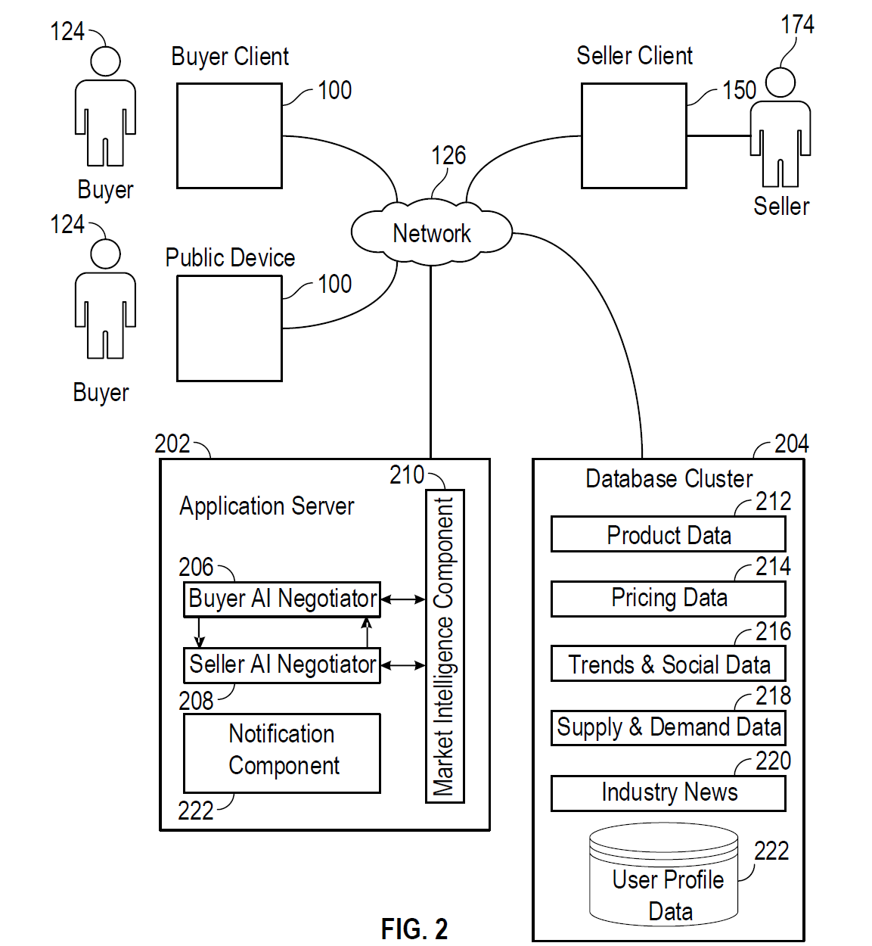
Here, all the different components are connected to a common network.The buyer clients can use a public device through which customers can select which product they are interested in and the application server with it’s components determines the best deals for that specific customer.On behalf of buyers,the AI bots will find the best deals negotiated for their interested product according to their budget and notify them through the public device.The database cluster contains all the information entered by the buyer client through the public device given to them.Business deals can also be communicated between buyer and seller,they have to enter their required budget and other data to the public device and on their behalf buyer AI bot and seller AI bot will
communicate according to their budget and complete business deals.

Slide 4
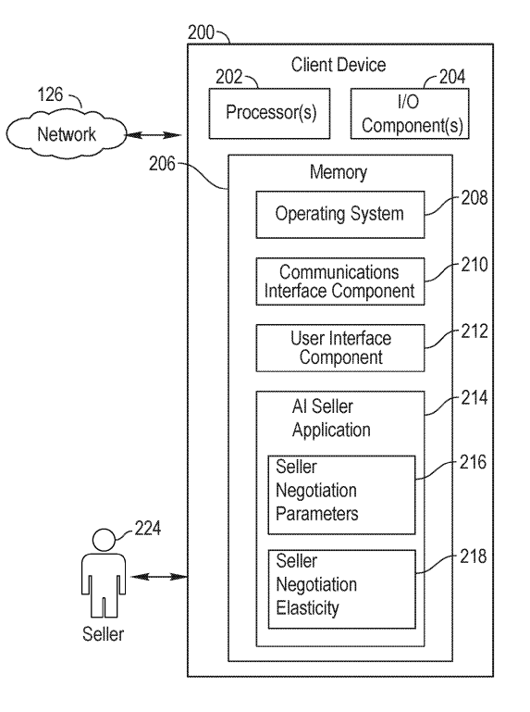
Here ,the seller can easily communicate with the clients through the client device
given to them ,through which clients can easily get information about the seller’s negotiation parameters and elasticity.
The AI Seller Application easily gives clients the required information about the seller.

Slide 5
CURRENT DRAWBACKS(PROBLEMS) IN SOCIETY
There are numerous outlets for purchasing products and services today. Information about products and services has virtually exploded in the Information Age. Between online product reviews, social media posts, product trends, user suggestions, blogs, frequently changing prices, loosely defined offers, and unreliable product/service providers, consumers today must sift through various online and brick-and-mortar retailers to find the best deals on the things they want to purchase. So consumers making purchasing product decisions often deal with information overload, market noise, pricing gaps, and conflicting product-review signals.
At the same time, retailers have to manage product and service advertisements across different advertisement channels (e.g., print, radio, television, online) that each requires different marketing techniques, and often complex campaign-management solutions. In the end, regardless of the medium, retailers must effectively predict what consumers want in order to better target and promote their offerings.
Also at the same time,business executives have to attend to business deals and negotiate them according to their budget.

Slide 6
HOW DRAWBACKS CAN BE SOLVED
Customers need not waste their time searching for good deals on the internet such as Amazon,flipkart since the artificial intelligence(AI) robots(agents) will be able to operate on behalf of the buyers and sellers to locate potential deals, automatically and anonymously negotiate towards the best terms for their respective users based on the parameters set by the users to be important and also based on market conditions.
Server-implemented framework that automates the discovery and negotiation of product sales online based on buyer- and seller-defined parameters and elasticity thresholds which saves a lot of time.
consumers making purchasing product decisions often deal with information overload, market noise, pricing gaps, and conflicting product-review signals but with AI robots joining a multiple negotiation stage together and finally giving the best potential deals to consumers,hence consumers won’t have any confusions in their decisions.

Slide 7
How more drawbacks can be solved
The AI agent for Sellers optimizes sales strategy and effectiveness while the AI agent for Buyers improves purchasing decision-making and empowers better deals with less effort.
Retailers have to check on salesmen and ensure that they are collecting information about what customers want in order to better target and promote their offerings,but with the implementation of AI robots they need not spend time ensuring and checking on salesmen.
Business executives need not attend business deals and spend time to negotiate it according to their preference ,since AI bots will be able to do all these work and business executives can tend to do more important tasks at office.

Slide 8

SOFTWARE AND HARDWARE RESOURCES REQUIRED FOR IMPLEMENTATION

Slide 9
COST TO IMPLEMENT THIS IDEA
Deploying a Artificial Intelligence (AI) robot(agents) cost can be as low as ₹5 lakh for entry-level Artificial Intelligence (AI) robots(agents), and can go up to ₹30- ₹40 lakh depending on the application, nature of job and the payload involved,"

Slide 10
JUSTIFICATION OF COST OF AI ROBOTS
1)Cutting Labor Costs
A typical robot system can easily produce the same amount of work as four workers. If you are running one robot system of three separate shifts a day, that one robot system is completing the same amount of work as 12 workers.
2) Uptime Advantages
Unlike manual workers, robot systems do not require lunches, days off, vacations, or sick days. They are able to work 24 hours a day, 7 days a week, with consistent, quality output.
3) Cutting Down on Errors
Robots are commonplace in the manufacturing industry and have been proven to be extremely reliable. When manufacturers choose to use manual welders, rather than robotic welders, they run the risk of not using certified welding procedures and relying on manual workers to properly deposit all required welds.

Slide 11
CHART of human work v/s AI robot work
Hours of work

Slide 12
GRAPH FOR PROFIT OF HUMAN SALESMAN V/S AI ROBOT in each day
Constant and high profit through AI Robot’s work
Profit in USD
Human salesman work
AI Robot work
Hours of work per day

Slide 13
APPLICATIONS OF MY IDEA
Artificial intelligence (AI) negotiation robots(agents) that can operate on behalf of the buyers and sellers to locate potential deals, automatically and anonymously negotiate towards the best terms for their respective users based on the parameters set by the users to be important and also based on market conditions.
The AI agent for Sellers optimizes sales strategy and effectiveness while the AI agent for Buyers improves purchasing decision-making and empowers better deals with less effort.
In an eCommerce context, a ‘Consumer Bot’ will be able to autonomously communicate with ‘Seller Bots’, and negotiate on your behalf for the right deal, based on your priorities and preferences. According to the referenced patent, negotiation is based on an optimization process within the decision space defined by consumer’s objectives and the explicitly set, or implicitly identified preferences.

Slide 14
MORE APPLICATIONS OF MY IDEA
Consumers could describe their objectives, priorities, budget and elasticity to their personal ‘Buyer Bots’, then release them to the market, to independently find the best possible deal.
Artificial intelligence robots(agents) will also be able to act as a salesman according to the preference of customers and also deliver packages to the customers which enables business executives to focus on more important tasks at office.

Slide 15

